Slide 1


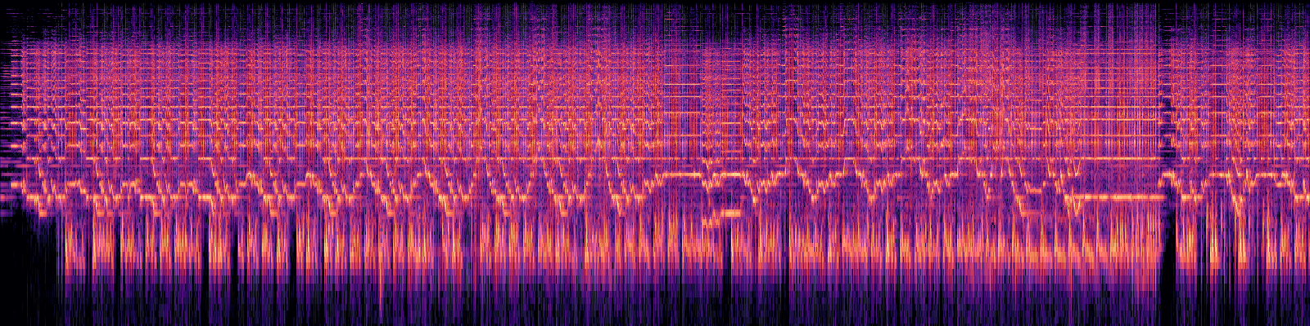
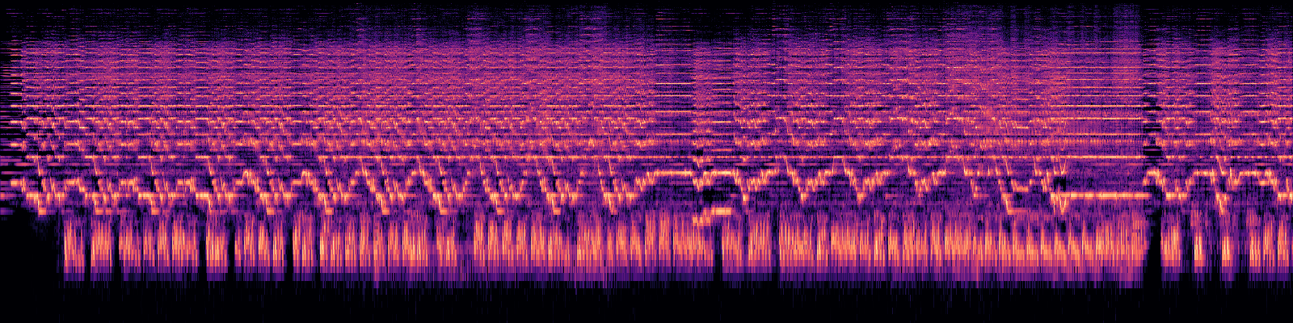
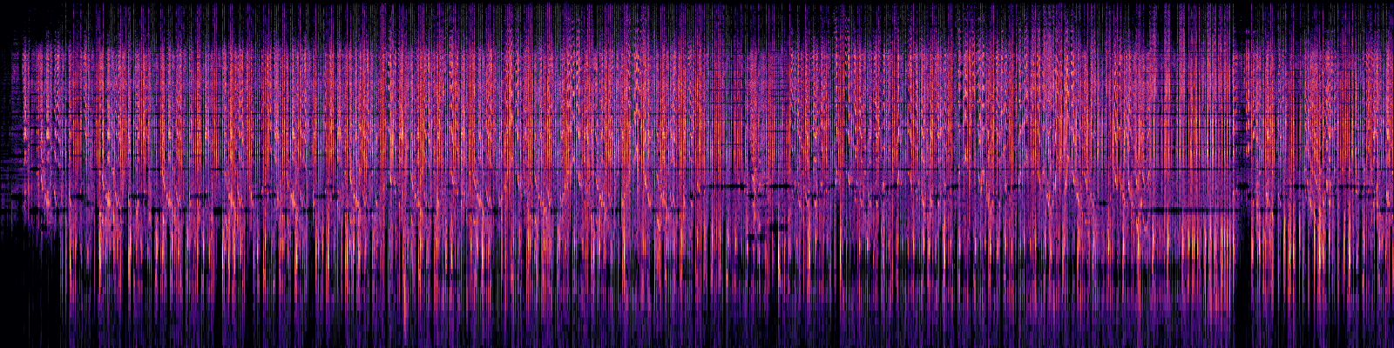
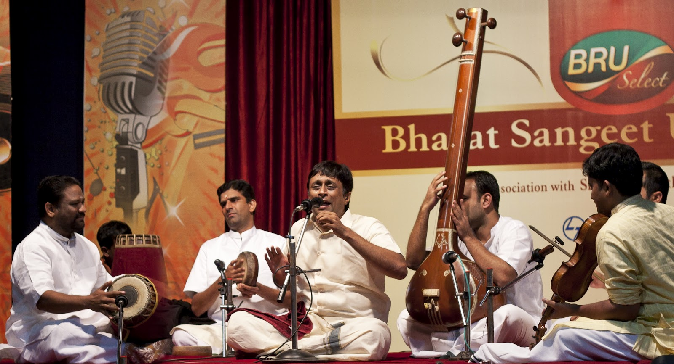
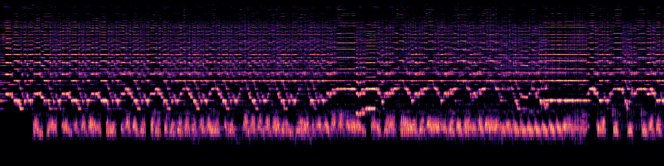
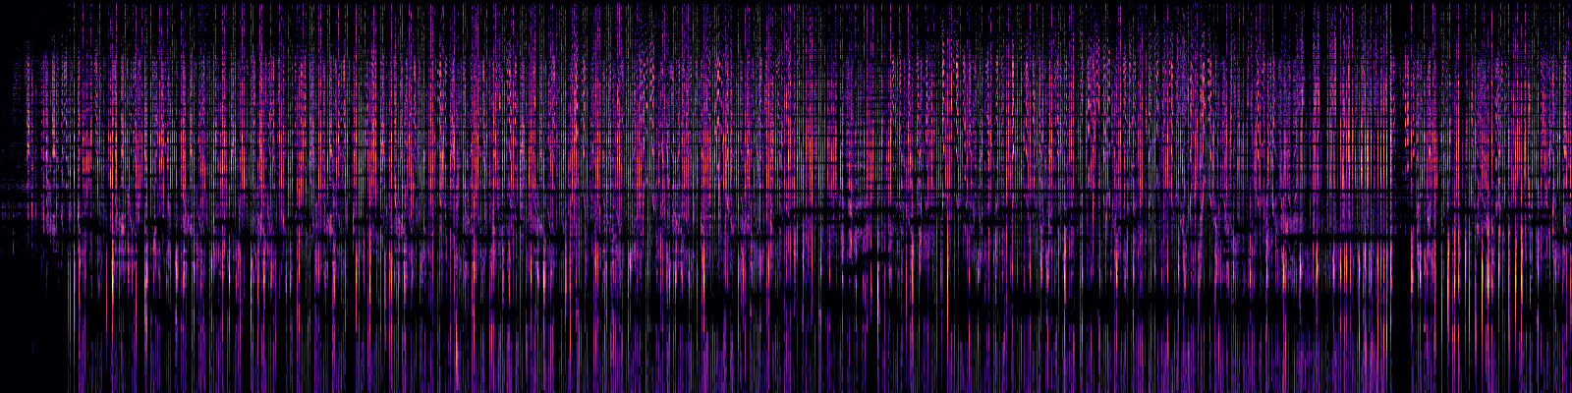
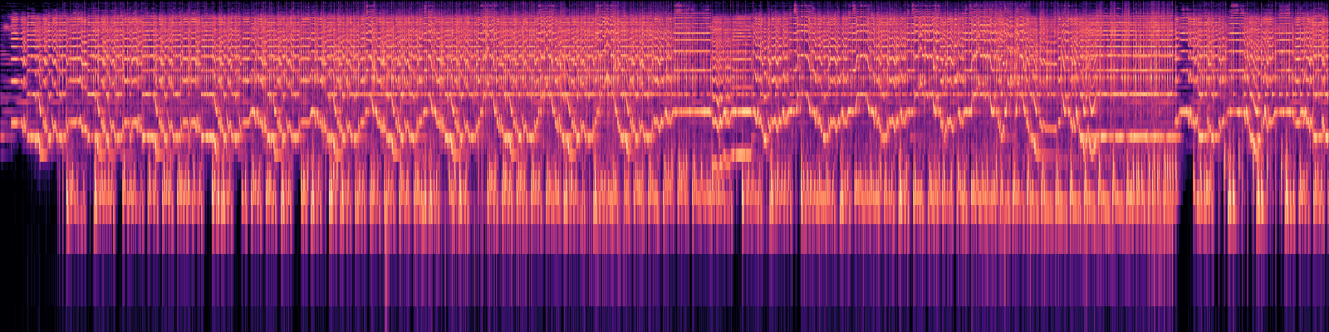
A Comparison of Machine Learning Approaches to Classify Tala
Alex Kan^{1,2}, Svetak Sundhar^{1,2}, Anthony Yang¹, and Akshay Sankar³
¹Department of Computer Science, University of North Carolina at Chapel Hill, NC 27599, USA
²Department of Statistics and Operations Research, University of North Carolina at Chapel Hill, NC 27599, USA
³Department of Biostatistics, University of North Carolina at Chapel Hill, NC 27599, USA
Summary: Here, we use various Machine Learning approaches to the classification of tala in Carnatic music. Accurate classification of tala can help students more easily self-learn compositions. The knowledge of this feature is extremely important when applying any type of Music Information Retrieval (MIR) strategies to the analysis of Carnatic music. We employ several methods stemming from traditional Statistical Learning, to more modern Deep Learning architectures in order to complete this task. Eventually, our goal is to ultimately extend this work beyond meter classification to the generation of new Carnatic music samples.
Motivation
Carnatic music is a sacred art form hailing from South India
As immigration to various countries continues to rise, it is becoming harder and harder to find Carnatic music teachers.
Our project seeks to classify the tala, or meter of a song, to help beginners learn Carnatic music.
Data
STFT
Harmonic (Margin 1)
Percussive (Margin 1)
Harmonic (Margin 8)
Percussive (Margin 8)
Introduction
Carnatic music consists of swara (melody) and laya (rhythm)
Annotated CompMusic dataset of 118 Carnatic songs of four different talas from the University of Pompeau Fabra.
Statistical Learning Models: KNN, Logistic Regression
Deep Learning Models:
2D CNN using melspectrogram input
2D CNN in parallel using harmonic and percussive inputs
Inception V3 using melspectrogram input
Melspectrogram
Experimental
Results
 | Hyperparameters | Accuracy
KNN | Variance: 0.80 Neighbors: 3 | 42%
Logistic Regression | Variance: 0.90 | 37%
2D CNN (shuffled) | Optimizer: Adam Dropout: 50% | 92%
Parallel 2D CNN | Optimizer: Adam Dropout: 50% | 25%
Inception V3 | Optimizer: SGD Learning Rate: 0.0001 Momentum: 0.90 | 50%
Methods
Statistical Learning
Preprocessing: Calculated 20 MFCCs¹, spectral flatness and tempo per frame from a 30 second snapshot of a song
Features were normalized and reduced via PCA
Used 10-fold cross validation to tune hyperparameters
Classifiers: kNN, Logistic Regression
Deep Learning
Hypothesis: treating the time-series classification problem as a texture recognition task on the frequency-time domain can improve model performance²
Hypothesis: treating harmonic and percussive elements separately can improve model performance
Preprocessing:
STFT and Melspectrogram
Decomposed STFT into harmonic and percussive elements
Fed 128x128x3 features into our CNNs
Conclusions
Basic statistical learning models can classify tala better than random chance but lack sufficient model performance
Deep learning models outperformed baseline models in predicting the tala of an audio signal from a different snapshot in time
Fine-tuning the Inception V3 pre-trained network on melspectrograms outperformed all other models in classifying the tala of new songs
Accurately classifying the tala is a complex task that may require significant data preprocessing and feature extraction
In the future: investigate recurrent neural networks to classify tala, and dimensionality reduction via ICA on model performance
References:
¹ Rethinking the Inception Architecture for Computer Vision, Szegedy et al.
² Classification of Time-Series Images Using Deep Learning Convolution Neural Networks, Hatami et al.
³ Deep Convolutional Neural Networks and Data Augmentation for Environmental Sound Classification, Salamon et al.
⁴ Features for Audio Classification, Breebaart et al.
Fall 2018, COMP 562 Poster Session

